Slide 1
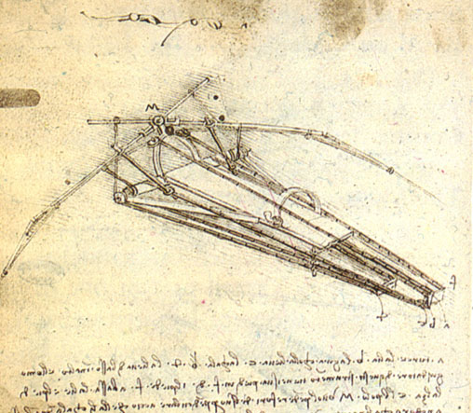

HY540 – Advanced Topics in Programming Language Development
Project

Slide 2

Project (1/11)
Small interpreted meta language named sin
  compile to AST and run
  no eval() is required (optional)
source
eval(expr)
normal execution
First-pass
(lexical and syntax analysis = parsing)
string
AST
first-pass (in-context parsing)
AST
Second-pass
(execution = semantic analysis and interpretation)
normal execution
execute

Slide 3
Project (2/11)
Untyped object-based with dynamically typed variables (like JavaScript)
Objects ex nihilo as field dictionaries
  Object construction expressions are optional
    { [<key> <value> (,<key> <value>)* ] }
    a = { x : 1, y : 2, z : f() };
    a= {}; a.x = 1; a.y =2; a.z = f();
  If object construction expressions are not supported, you need basically the expression {} to imply “make a new object”

Slide 4
Project (3/11)
Basic reference counting for objects
  very primitive garbage collection not working for cyclic references
All key types are allowed but are treated as strings just before hashing
    t[0] ≡ t[“0”]
    t[t] ≡ t[“object(0x12)”)
      assuming unique serial number for objects, else you may use the native object address or reference
  Reserve a keys and size key that can’t collide with user-defined keys
    keys = object with all keys, size = number of fields
    e.g. a.#keys and a.#size

Slide 5
Project (4/11)
Simple syntax but always of your choice
  You may want to justify that
  Don’t be biased or affected by the syntax of my previous or later examples
Statement based
  Notion of a global program as a series of statements with the following simplifications
    Nested functions but no access to outer locals (only globals)
    No closures
    No lambda (anonymous functions) - optional
    No true methods (only syntactic sugar)
      a->f(b) ≡ a.f(a, b) assuming -> means method invocation
    No functors - optional
    No function expressions - optional

Slide 6
Project (5/11)
Function environment fenv is a hash table Environment (internal object) carrying
  Arguments
  Locals
Global variables are stored in a global genv that is used for variables outside functions
Inside functions genv and fenv are normally accessed
  with every function call getting its reserved fenv copy
  created at call site (caller) with the actual arguments and then expanded at the callee site (called) with the locals

Slide 7
Project (6/11)
Extensible library functions programmed in native code
  the language in which you make the sin
  Environment as parameter to library functions
    to extract actual arguments
  You need also a way to return a value from library functions
    you can reserve a retval field in the Environment object
    the environment is also to be destroyed at the call site after the invocation returns and the return value is (optionally) taken

Slide 8
Project (7/11)
You will need to support native objects (pointers or references) as types in sin
  those are returned by library functions and they are created and managed exclusively by native code
You will need this feature since
  ASTs will be native objects
  handled by the set of tree manipulation library functions you will create and install

Slide 9
Project (8/11)
Basic metaprogramming features of sin
  .< expr >. shift to meta level (expr → AST)
  .~ var assume var already carries an AST
  .! expr compile (execute) an AST (meta expression)
Optional features
  .@ expr compile a string (runtime) expr to an AST
  eval(expr) is .!.@expr
  .# expr unparse a meta expression (AST→text)
There is no separation of metafunctions from normal functions
  In principle, any program expression may be meta code
  You can use .! to compile a manually produced AST via lib functions

Slide 10
Project (9/11)
Metaprograms you may develop for testing (1/2)
  simple local optimizations
    optimized versions of functions like power
    loop unrolling for statically known number of iterations
  adding diagnostics into functions
    wrapping invocations to specific functions with before and after messages
  aspectual transformations
    simple advice for simple code patterns like adding Design by Contract calls in methods
      in every function f with a self first argument add the following code:
        precond = self.pref_f; if (precond) precond(self);

Slide 11
Project (10/11)
Metaprograms you may develop for testing (2/2)
  generating object factories
    Meta functions accepting pairs of slot identifiers and initial values, producing a respective object factory function
      st_factory = .!factory(“name”, “”, “address”, “”, “semester”, 1);
      student = st_factory.new();
  static function analysis
    exit paths compile warnings
    simple dead code elimination if (false), return; <code>
    assignment in condition compile warnings
  static function style checker
    function size in statements
    expression complexity

Slide 12
Project (11/11)
Rules and terms
  Up to four persons
  Any implementation language allowed
  No report needed
  Examination is a formal presentation
  Examples from three categories at least required
  Presentation date (final) is Wednesday 09/09/09
  Plenary discussions with all teams biweekly possible

